Slide 1
Smart Librarian AI RAG-based book recommendations app
that uses ChromaDB for semantic retrieval and a local tool for summaries.
Taradaciuc Nicolae 1 / 9

Slide 2

Main Application Features
Search by title, author, or genre and open exact summaries directly.
The summary comes from a local tool, not from model invention.
Catalog browsing and search
Summary retrieval
1
3
5
2
4
Voice, audio, and image support
Google Books import
AI book recommendations
New books can be ingested, normalized, and merged into the catalog.
Semantic matching based on themes, genres, and context.
Speech input, narration, and representative visuals are available as extras.
2 / 9

Slide 3
Architecture & Core Flow
Streamlit UI
Retrieval layer
Local sources & response
Chat input
Sidebar controls
Embeddings
ChromaDB
JSON catalog
Response builder
Final output
1
2
3
4
5
Safety & control
LLM & tool calling
Guardrails
Language + scope
OpenAI moderation
GPT chooses
get_summary_by_title(title)
3 / 9

Slide 4
Extra Features & Safety
Safety layers
Optional capabilities
Local filtering
Bilingual UI
Input cleaning and blocked-term lists can stop inappropriate requests before they reach the LLM.
The project supports Romanian and English for both input understanding and response rendering.
Scope and language handling
Voice and audio
The app checks if the request is book-related and adapts behavior for Romanian or English.
Voice input can be transcribed, and final recommendations can be narrated with TTS.
OpenAI moderation
Image generation
Input and output moderation add a remote safety layer on top of the local checks.
The UI can create a representative cover concept or scene inspired by the recommendation.
4 / 9

Slide 5
End-to-End System Flow
PHASE 1 - CATALOG UPDATE FLOW
Google Books API
Normalize metadata
Update
book_summaries.json
Refresh tool cache
Rebuild ChromaDB
01
02
03
04
05
Catalog ready for runtime
PHASE 2 - MAIN RUNTIME FLOW
Streamlit UI
Guardrails
Language
Detection
Scope Check
OpenAI Moderation
(input)
Embeddings
ChromaDB
06
07
08
09
10
11
12
GPT
Local Tool
JSON Catalog
Response Builder
OpenAI Moderation
(output, optional)
Final Response
13
14
15
16
17
18
5 / 9

Slide 6
Testing & limitations
What was tested
Known limitations
retrieval + tool-calling orchestration
guardrails, scope detection, and moderation
data loading and title normalization
import refresh behavior
language, audio, image, and speech helpers
recommendation quality depends on catalog quality
imported Google Books metadata may be noisy or inconsistent
some image requests may still be blocked by safety policies
6 / 9

Slide 7


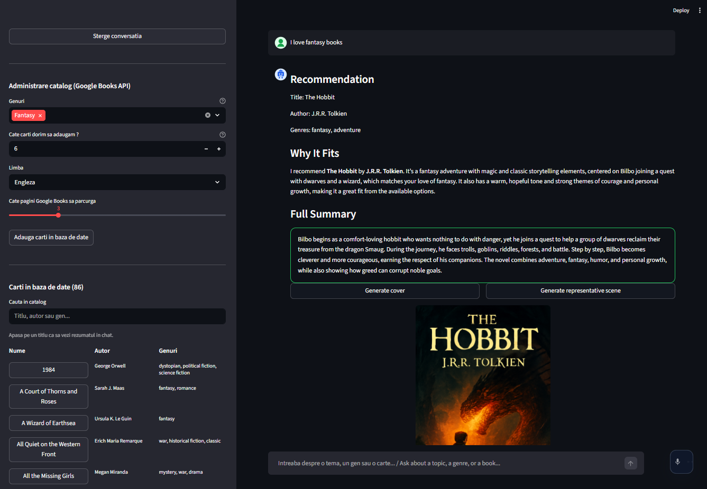
Live Demo
Google Books import & Catalog browsing and search
Recommendation Flow
LIVE APP
7 / 9

Slide 8

Questions
Conclusions
Taradaciuc Nicolae SLIDE 8 / 9

Slide 9
Thank you!
Taradaciuc Nicolae SLIDE 9 / 9

